Slide 1
Every Student Succeeds Act (ESSA)
Title I, Part A Program Parent Annual Meeting
(Insert School Name Here)
Date: 00/00/2018
Presenter:
First and last name
Title
Notes:
COMPLETE SLIDE: School Name, Date, Presenter Name, Role

Slide 2
Title I, Part A Program-Definition
Definition
Title I, Part A is a formula grant program that provides financial assistance to local educational agencies (LEAs) and schools with high numbers or high percentages of children from low-income families . Formula grant programs are noncompetitive awards based on a predetermined formula . Title I is the largest program supporting elementary and
secondary education in the Every Student Succeeds Act (ESSA) .

Slide 3
Title I, Part A Program- Purpose
Purpose
The Title I, Part A program is intended to help ensure that all children meet challenging state academic standards,
regardless of economic status . Title I is the government’s attempt to provide all children with the opportunity to
receive a fair, equitable and high-quality education, and to close the achievement gap .

Slide 4
How Schools Qualify
Campuses with a low-income enrolled percentage of 40%-100% are considered “school-wide” campuses.
Campuses with a low-income enrolled percentage of 35-39% are considered a “targeted assistance” campus.
Campuses with a low-income enrolled percentage below 35% are not eligible for Title I funds.
Notes:
Let the parents know if your campus is school-wide or targeted assistance.

Slide 5
Title I Annual Meeting
These “supplemental” federal funds are used to:
Accelerate instruction for struggling students,
Provide professional-development for teachers, paraprofessionals, and administrators
Hire certified personnel,
Provide additional resources – technology, personnel, materials, instructional programs, software, and
Encourage parent and family involvement.

Slide 6
Supplemental Dollars?
This means that Title I, Part A funds cannot be used to provide services that are required by:
  State Law
  State Board of Education Rule
  Local Policy
Notes:
Examples: purchasing text books that are required, paying for school furniture, playground equipment-these items are NOT supplemental and may not be purchased with Title I funds.

Slide 7
(Insert Your School Name Here)
At (Insert Your School Name Here) we spend our Title I dollars on:
  1…
  2…
  3…
Notes:
On this slide you must insert the name of your school and how you spend your Title I dollars. This can be very generic. Ex: we spend our Title I dollars on a classroom reduction teacher in third grade, we pay for a counselor, we pay for extra duty pay for tutorials so our students can master the states objectives.

Slide 8
Parent and Family Engagement
Research has proven that students whose parents are involved in their child’s education have greater success in school.
So, the Title I Grant supports activities that focus on parental and family involvement.
Notes:
At this point you want to encourage parental participation in their child's education. Ex: carefully reviewing the weekly folders, checking grade speed weekly, making appointments to talk to teacher, attending PAC meetings (you may want to explain that PAC is different than PTO), reading to their child every day, etc.

Slide 9
Parental Involvement Requirements
Parent Notifications (These are regular written communications to inform parents).
Examples of parent notifications are:
  School-Parent Compact (These are statements of shared responsibilities).
  Parent and Family Engagement Policy (This is a plan to involve parents).
Notes:
Explain to parents that the school-parent compact outlines how parents, the entire school staff, and students will share the responsibility for improved student academic achievement. This document should stress the importance of communication between teachers and parents on an ongoing basis. It will outline the school’s role to providing high-quality curriculum and instruction in a positive environment. Make sure to add that the Parent has a very important role in supporting their child’s learning. Your school compact may also include the student’s role in their own learning. Let parents know when the compact will be (or was) sent home. You may want to have some extras on hand incase your compact has already been sent home and parents may not have received it. You can also direct them to your website where you have it posted on line.
Discuss the Parent Involvement Policy. Let parents know that you would like to ask for volunteers to review both the policy and compact from last year and see if any changes need to be made.
Let parents know how the Parent Notification will be sent home.

Slide 10
Parental Involvement Requirements
Title I Parent Meetings – These are regular face-to-face meetings to provide trainings to parents as well as collaborate with them about the progress of their child’s education.
Parent Involvement Surveys – The External Funding Department will provide a parent survey at the end of the school year to evaluate the campus’ Title I, Part A Parent Involvement Program.
Notes:
It would be a good idea to have a calendar of dates and times that your Title I Parent meetings will be conducted so you can hand it out to parents at this meeting. Let parents know that in April/May 2018 they will have the opportunity to give their input in the Title I, Parent Involvement Parent Survey. Let parents know that while this survey is completed on line, they are welcome to come on campus and a computer will be made available to them so they may complete the survey.

Slide 11
(Insert Your School Name Here)
At (Insert Your School Name Here) we want you to be involved. Here are some ways that you can be involved in your child's school:
  1…
  2…
  3…
Notes:
Please add your school name to this slide and list ways that the parents can become involved in your school this year.

Slide 12
Other Requirements
The Federal Report Card This report card informs parents of the performance of the campus.
  At (Insert Your School Name Here) we send a letter home with an internet link to the report card for our school.
  We also make a copy available ______________
Notes:
Please add your school information to this slide.

Slide 13

Socioeconomic Information Form vs Free/Reduced Lunch Form

Slide 14

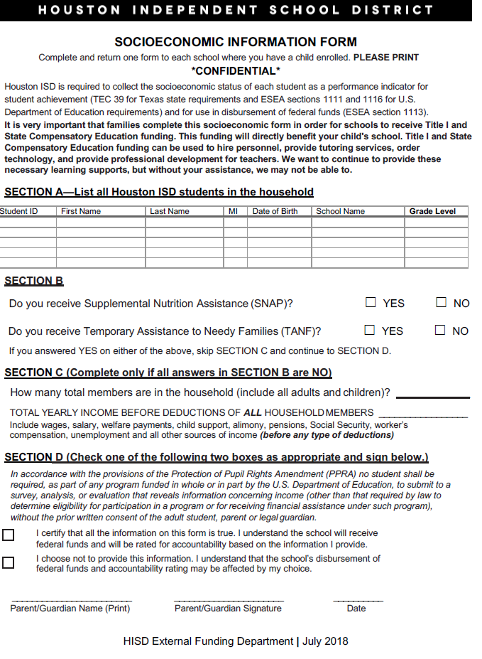
Socioeconomic Information Form

Slide 15

Socioeconomic Information Form
How does the Socioeconomic Information Form impact funding on Title I campuses?
  It is very important to complete the Socioeconomic Information Form in order for the school to receive Title I, Part A and State Compensatory Education funding.
  This funding directly impacts instructional programs and other services. Title I, Part A and State Compensatory Education funding is utilized for:
  personnel
  tutoring services
  technology
  professional development for teachers
  after school programs
  waived fees for in-state college applications
Information provided by the Socioeconomic Information Form also affects accountability systems, including Domain II
(Domain II campuses are compared to other campuses with the same percentage of economically disadvantaged students).
Any information provided on this form will be used for HISD purposes ONLY.
Parents are strongly encouraged to complete and submit the Socioeconomic Information Form.

Slide 16
(Insert Your School Name Here)
At (Insert Your School Name Here) we are committed to using our Title I funds to impact student learning and achievement to the maximum!
Notes:
Please add your school name to this slide.

Slide 17
Remember that…
The External Funding Department (Title I) is fundamentally focused to providing quality support to all Title I campuses and central office staff to ensure that all students achieve academic success.
Pamela Evans, Director
External Funding Department (Titles I, II & IV)

Slide 18
Questions?
(Insert Your School Name Here)
Name of Title I Campus Contact, Title I Contact
Email Address
Phone Number
Notes:
Please add your personal contact information on this page.

Slide 19
Thank you
Date: 00/00/2018
Presenter:
First and last name
Title

